Slide 1
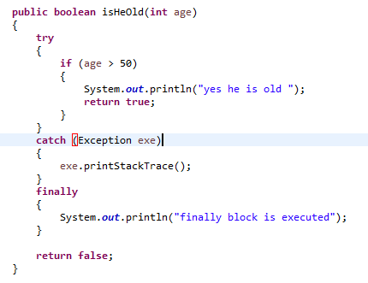
finally
Will finally would execute even if there is a return statement?
The answer is yes. finally block will execute every time. The only case when it doesn’t execute is when it encounters System.exit().

